Slide 1




NEXT GEN EMPLOYABILITY PROGRAM
Creating a future-ready workforce
Team Members
College Name
Student Name : Yabesh Jesilen V
Student ID :au951221104059
JP College Of Engineering

Slide 2

CAPSTONE PROJECT SHOWCASE
Project Title
Voting Web Application using Django Framework
Abstract | Problem Statement | Project Overview | Proposed Solution | Technology Used | Modelling & Results | Conclusion

Slide 3
Abstract
This project aims to develop a web application using the Django framework for conducting online polls and voting. The application allows users to view and participate in polls, submit their votes, and view real-time results. Key features include user authentication, creation of new polls, and interactive user interface. The project aims to provide a user-friendly and engaging platform for conducting various types of polls and gathering opinions from participants.

Slide 4
Problem Statement
Limited Engagement in Traditional Voting Systems: Traditional methods of conducting polls and voting often lack engagement and accessibility, leading to low participation rates and limited representation of diverse opinions.
Complexity in Poll Creation and Management: Existing platforms for creating and managing polls may be complex and require technical expertise, making it challenging for non-technical users to conduct their own polls effectively.
Lack of Real-time Interaction and Feedback: Many polling systems do not provide real-time interaction and feedback, hindering the ability to engage users dynamically and limiting the effectiveness of gathering timely insights and responses.

Slide 5
Project Overview
Develop a user-friendly web app using Django for facilitating online polls and voting.
Enhance engagement by enabling easy participation, vote submission, and real-time result viewing.
User Authentication: Ensure secure access for users to the platform.
Poll Creation: Enable intuitive creation and management of polls with customizable questions and choices.
Individuals, organizations, and communities seeking efficient polling solutions.
Students, professionals, community leaders, and businesses looking for interactive decision-making tools.

Slide 6
Proposed Solution
.
Our solution entails developing a robust web application leveraging Django's framework to streamline the process of conducting online polls and voting. By prioritizing user-friendliness, we aim to create an intuitive platform where users can effortlessly create, participate in, and analyze polls. Through features like user authentication and real-time result updates, we ensure both security and engagement throughout the voting process
1.Django Framework Utilization
2.User-Friendly Interface Design
3.Secure User Authentication
4.Real-Time Result Updates
5.Customizable Poll Creation
6.Responsive Design for Accessibility
7.Scalable Infrastructure
8.Community Engagement

Slide 7
Advantages:
The user-friendly interface and real-time result updates foster greater engagement among participants, encouraging active involvement in the voting process.
By providing a seamless platform for creating and participating in polls, our solution improves the efficiency of decision-making processes and enhances accessibility for a wide range of users.
With customizable poll creation options and scalability, our solution can be tailored to suit diverse needs and adapted for various domains, ensuring flexibility and relevance across different contexts.

Slide 8
Disadvantages:
The user-friendly interface and real-time result updates foster greater engagement among participants, encouraging active involvement in the voting process.
By providing a seamless platform for creating and participating in polls, our solution improves the efficiency of decision-making processes and enhances accessibility for a wide range of users.
With customizable poll creation options and scalability, our solution can be tailored to suit diverse needs and adapted for various domains, ensuring flexibility and relevance across different contexts.

Slide 9
Technology Used
Front-end
1.HTML
2.CSS
3.Java Script
4.Bootstrap
Back-end
1.Python
2.Django
3.SQL

Slide 10
Modelling & Results
Utilizing Django's model system, we structure data entities such as User, Poll, Choice, and Vote to represent users, polls, poll choices, and user votes respectively, ensuring efficient data management and relationships.
Users can create polls with customized questions and choices, and other users can participate by submitting their votes. Each vote is recorded and associated with the respective choice and user.In developing a voting application using Django, meticulous attention is directed towards both modeling the underlying data structure and effectively presenting the voting results to users.
As votes are submitted, the system dynamically updates the poll results, providing users with instant feedback on the current standings of each choice.
Our solution includes features for analyzing poll results, such as visualizations and statistical summaries, empowering users to gain insights into voting patterns and preferences.

Slide 11
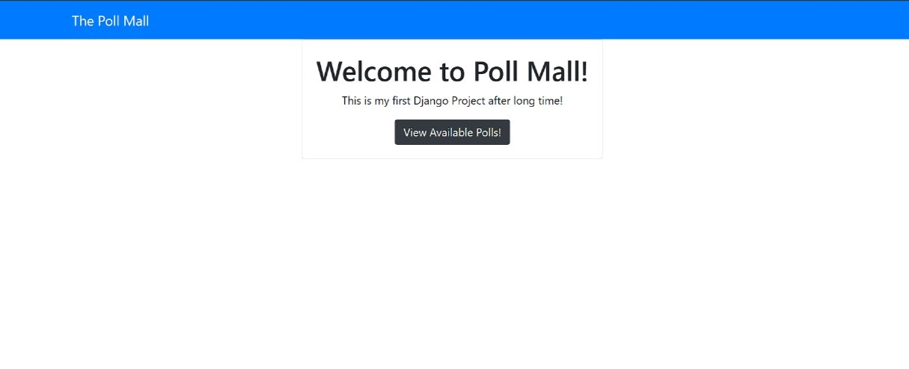
Homepage

Slide 12
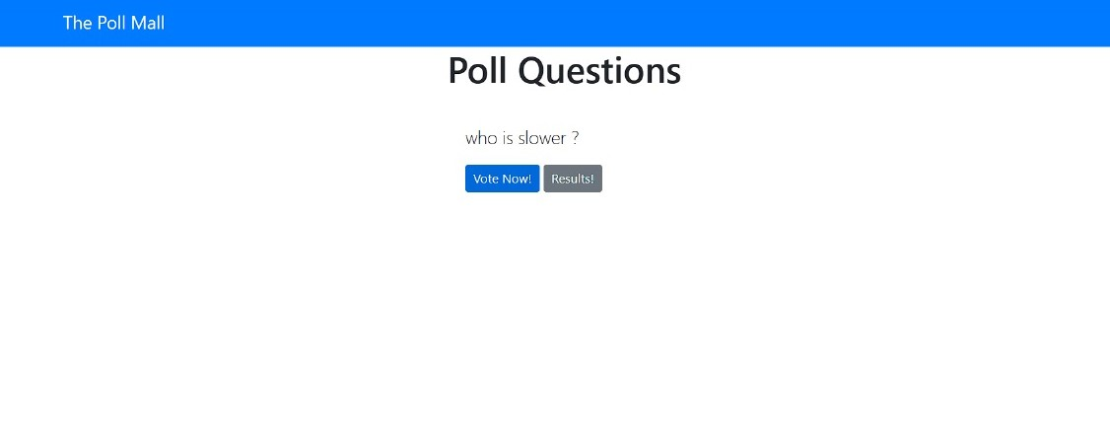
Polling Questions Page

Slide 13
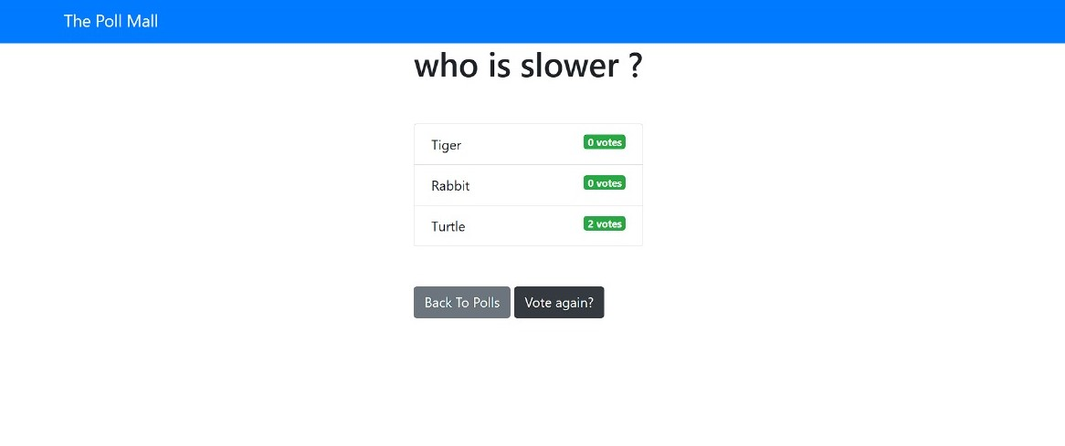
Voting Page

Slide 14
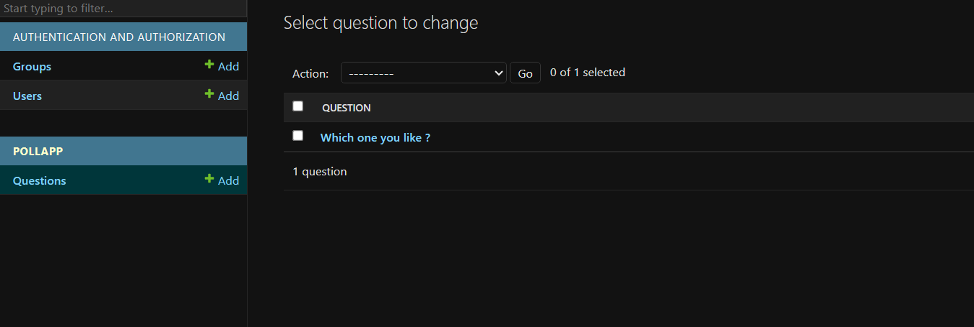
Admin-Page

Slide 15
Future Enhancements:
Integrate advanced analytics features such as trend analysis, demographic breakdowns, and predictive modeling to provide deeper insights into voting behaviors and preferences.
Implement interactive elements such as live polling sessions, real-time chat functionalities, and interactive visualizations to further engage users and encourage participation.
Enable seamless integration with popular social media platforms and collaboration tools to expand reach and facilitate sharing of polls, fostering greater community involvement and awareness.
Explore incorporating machine learning algorithms for tasks such as sentiment analysis of poll responses, personalized recommendations for poll topics, and automated moderation of user-generated content to enhance the overall user experience and decision-making process.

Slide 16
Conclusion
In conclusion, our Django-based voting web application presents a comprehensive solution for conducting online polls and voting with efficiency, accessibility, and engagement at its core. By leveraging Django's framework, we have developed a user-friendly platform that facilitates poll creation, participation, and result analysis. The inclusion of real-time result updates and customizable poll features ensures an interactive and dynamic voting experience for users. Moving forward, the potential for future enhancements such as advanced analytics, interactive features, external platform integration, and machine learning integration holds promise for further enriching the functionality and impact of our application. Overall, our project embodies a commitment to democratizing decision-making processes and fostering inclusive participation in shaping collective outcomes.

Slide 17
Thank You!
Notes:
Thank You !!

